Slide 1
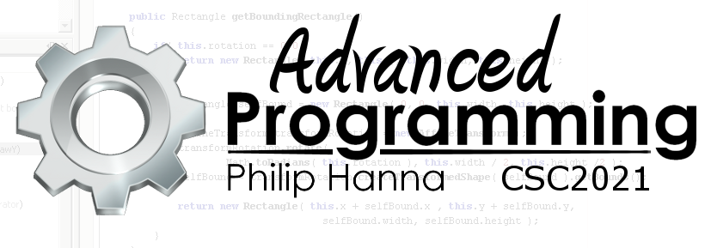
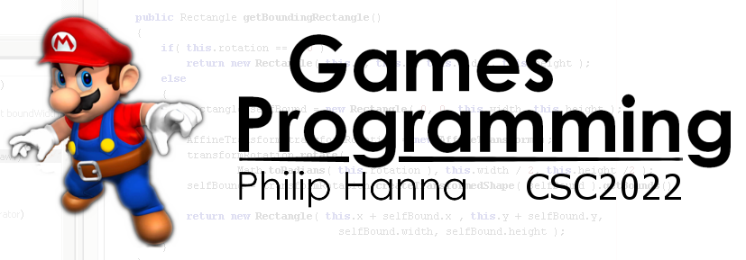
Collision Detection
Enabling game objects to detect inter-object collision

Slide 2
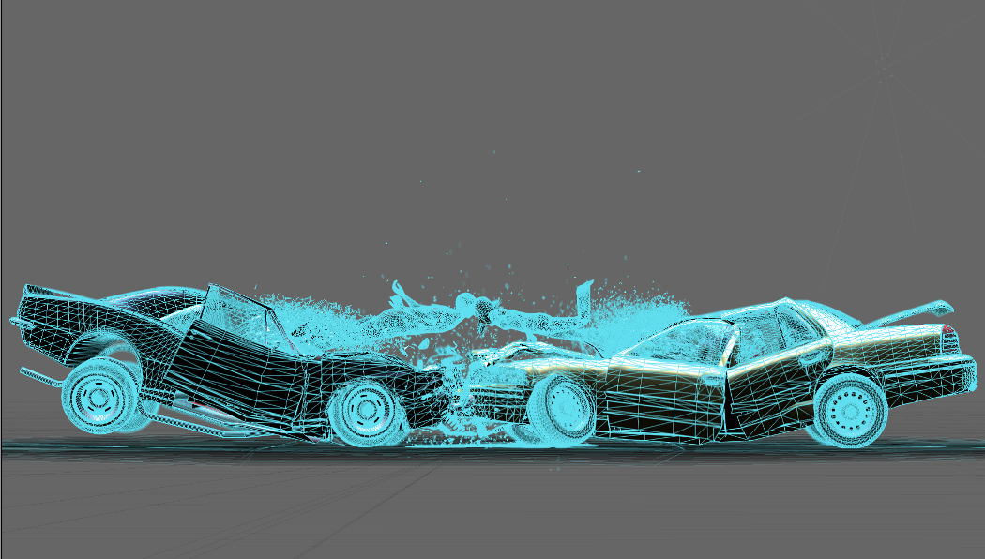
Collision Detection

Slide 3
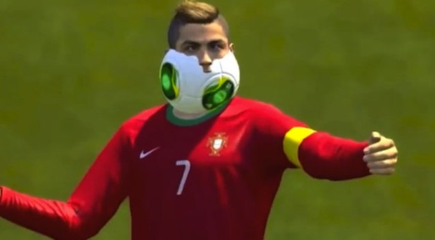
Most video games need to detect when two game objects intersect one another in order to trigger an appropriate action.
For example, detecting and then separating intersecting objects provides the appearance of ‘solidity’ within the game world.

Slide 4
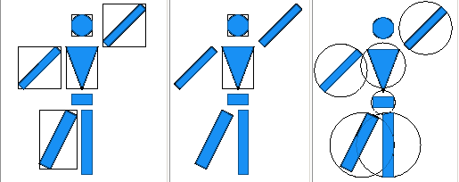
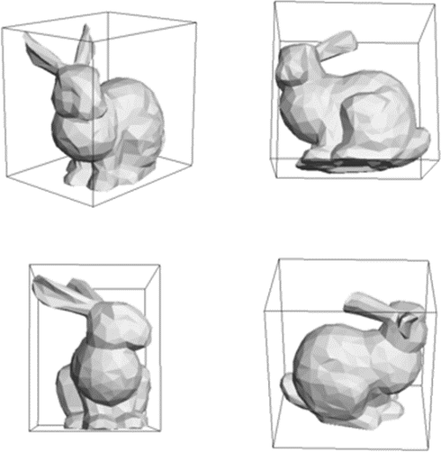
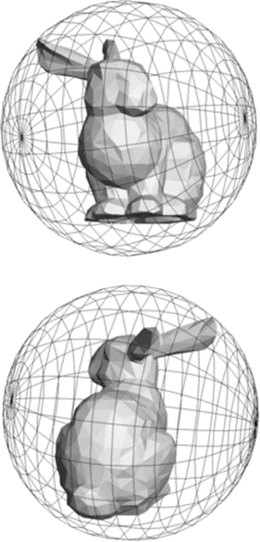
Game objects are often ‘bound’ using a simple geometric shape that can be tested against other bounds to detect collision.
Common 2D bounds include:
Axis-aligned Box
Oriented Box
Circle
Axis-aligned Box Oriented Box Circle
Aside: Similar 3D bounds also exist.

Slide 5
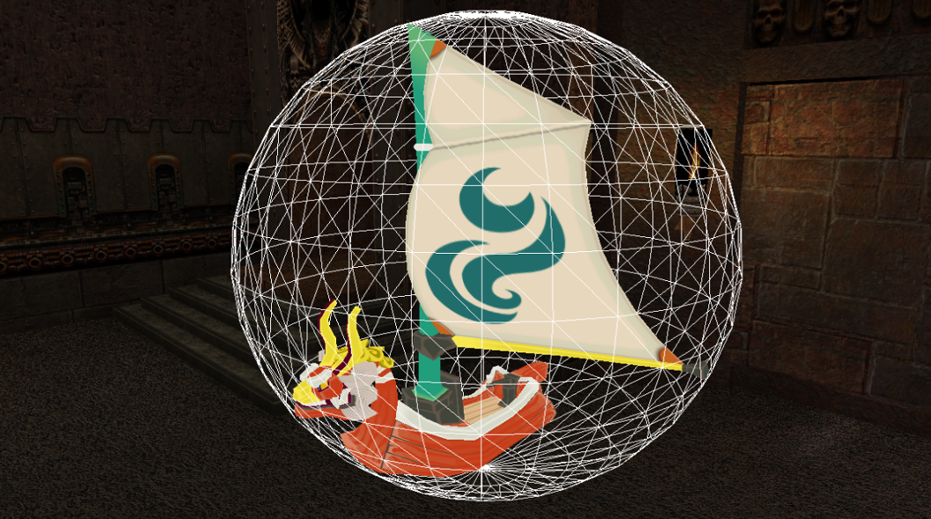
Bounding
Circles

Slide 6
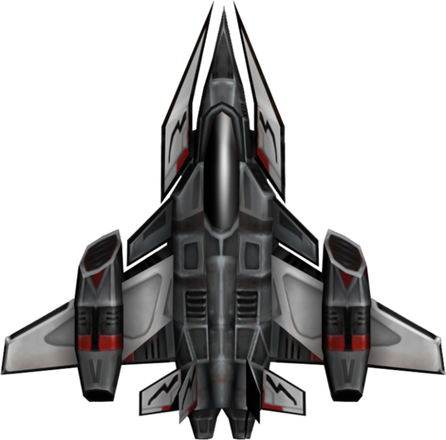
Full shape bound
The simplest bound/test is that of a circle (or sphere in 3d).
It is obviously good for objects that are somewhat circular in proportion or for objects that can rotate.
Core shape bound

Slide 7
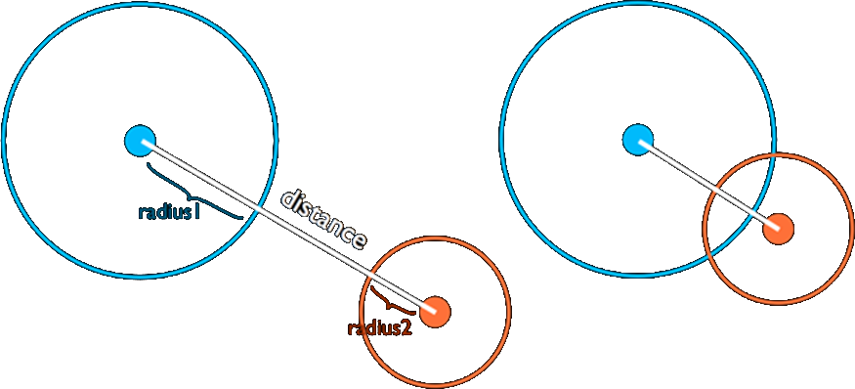
To test for collision with another bounding circle, compare the distance between the two centres with the sum of the two radii;
isCollision(Circle c1, Circle c2) {
float distX = c1.x – c2.x;
float distY = c1.y – c2.y;
float squaredist =
(distX * distX) + (distY * distY)
float sumRadii = c1.radius + c2.radius;
return squaredist <= sumRadii * sumRadii;
}
No collision:
Distance > radius1+radius2
Collision:
Distance <= radius1+radius2
Get squared distance with Pythagoras
Aside: Distanced squared is used to avoid an expensive sqrt calculation.

Slide 8
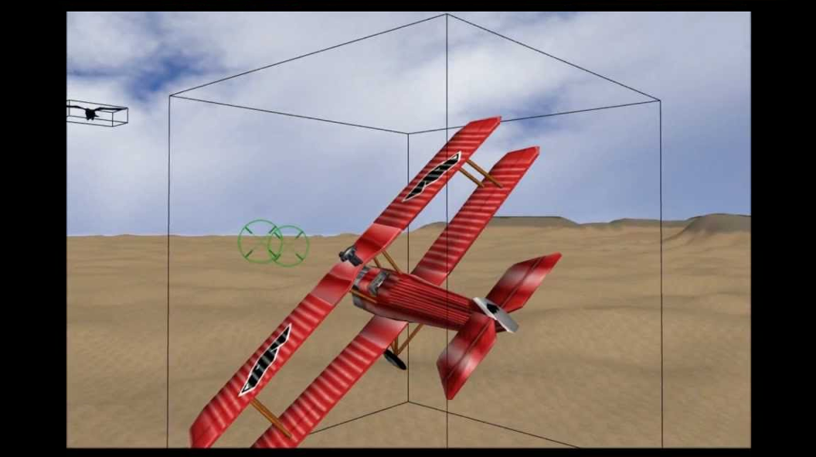
Axis-Aligned Box

Slide 9
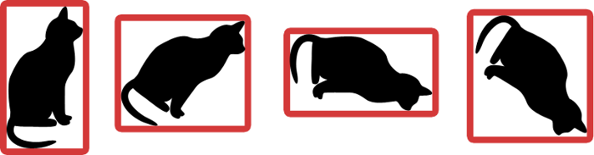
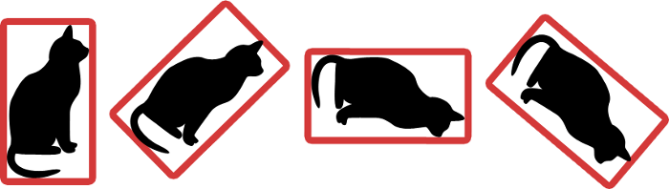
Axis-aligned bounding boxes
An axis-aligned bounding box (AABB) is aligned with the axis (it cannot rotate and may change size if the bounded object rotates).
It is good for bounding rectangular shaped objects that do not rotate.
An oriented bounding box (OBB) (one that can rotate) can be used for objects that rotate. Although, collision detection between two OBBs is notably more complex.
Oriented bounding boxes

Slide 10
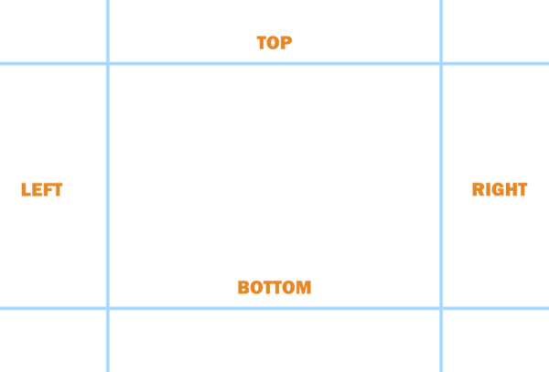
It is easy/quick to determine if two AABBs do not intersect. The intersection test will determine if they do not overlap and return the negated result.
Two AABB (A and B) do not intersect if any of the following conditions are true:
A’s bottom edge is above B’s top edge.
A′s top edge is below B′s bottom edge.
A′s left edge is to the right of B′s right edge.
A′s right edge is to the left of B′s left edge

Slide 11
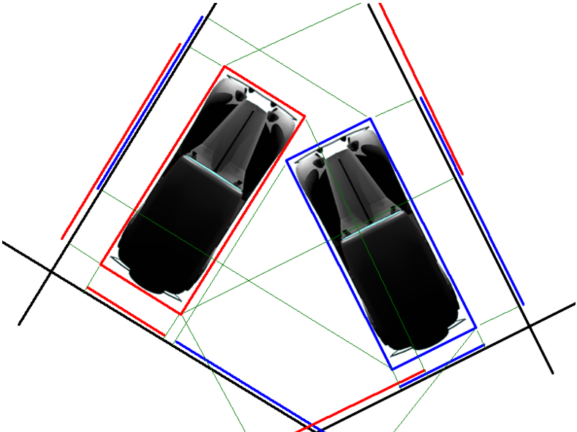
Other Aspects

Slide 12
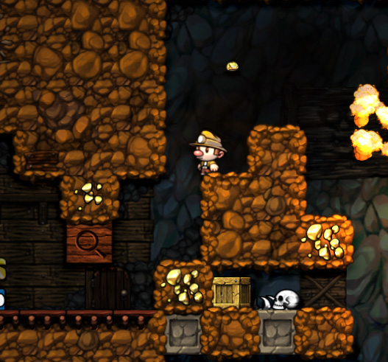
Grid-based Approaches
It a tile or grid based world, a bounding box can be easily calculate for a given tile.
Based on the player’s location and size, the tiles that need to be tested for collision can be determined.

Slide 13
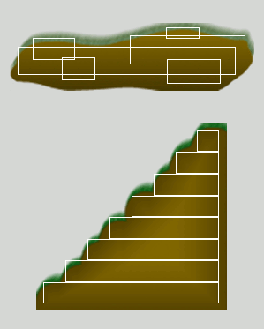
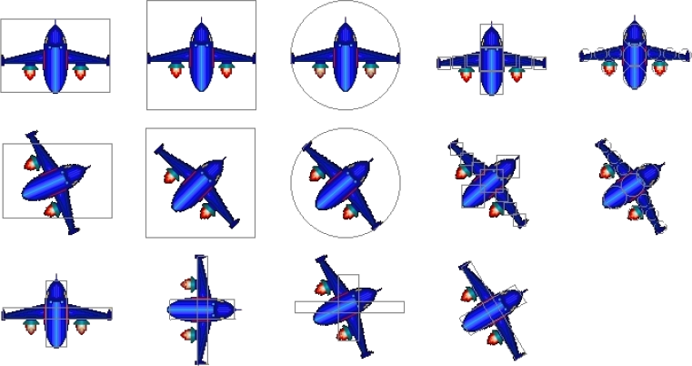
Multiple Bounds
A game object may use multiple bounds to provide more accurate collision detection. Likewise, uneven terrain with the game might use several bounds.

Slide 14
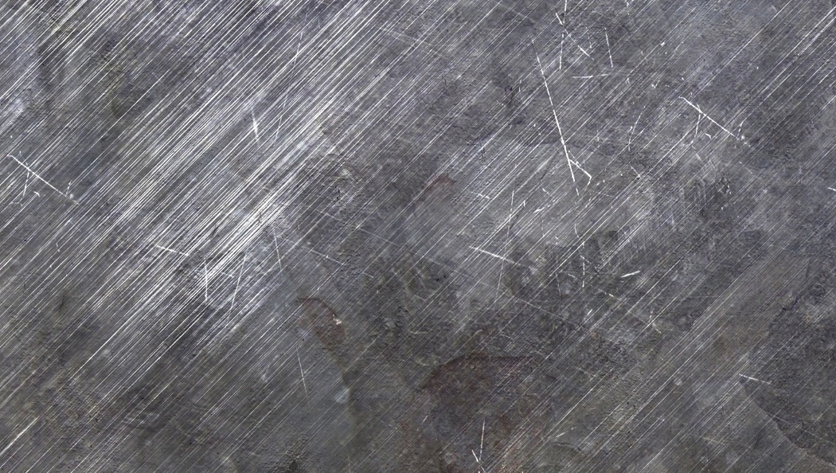
Collision detection and resolution is a large area.
We are very much only scratching the surface here (but sufficiently so for most projects).

Slide 15

Key takeaways:
By using simple geometric bounds (e.g. circles, AABBs) we can detect, without too much effort, when two game objects overlap.

